Slide 1
Project Title - Iris Flower Classification
Name: KRISHNA KUNAL
Roll no- 2312res340
Date: 19 August 2025

Slide 2
GUVI(HCL)Project:-2
Iris Flower Classification
Problem Statement:
Manually identifying the species of a flower based on its physical measurements can be slow and
prone to error. Automating this process using machine learning enables faster, more accurate
classification based on reliable feature patterns.

Slide 3
Project Description
Classify iris flowers into Setosa, Versicolor, or Virginica
Based on Sepal Length, Sepal Width, Petal Length, Petal Width
Manual identification is slow and error-prone.
Automating increases speed, accuracy, and consistency.

Slide 4
Tools & Libraries Used
Python
import pandas as pd
import numpy as np
import matplotlib.pyplot as plt
import seaborn as sns
ALL CODE IS IN THE GITHUB

Slide 5
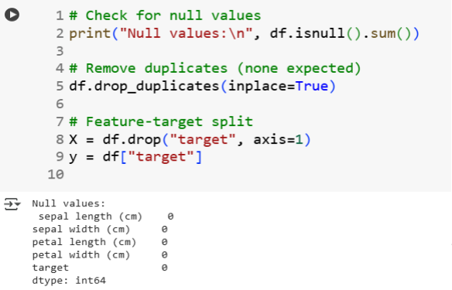
Data Cleaning & Pipeline
Checked for null values (none found).
Removed duplicates.
Split into features (X) and target (y).
Train-test split: 80% train, 20% test.

Slide 6

Exploratory Data Analysis (EDA)
• Used pairplot to visualize feature relationships.
• Clear separation for Setosa; partial overlap for others.
• Indicates strong feature separability.

Slide 7
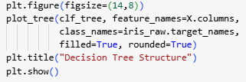
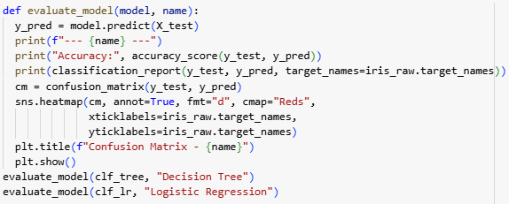
Model Evaluation
• Accuracy: 100% for both models.
• Classification Report: Precision, Recall, F1 all 1.00.
• Confusion Matrix: Perfect classification.

Slide 8
Future Work
Test on a larger floral dataset.
Deploy as a web app for real-time predictions.
Integrate edge device deployment for field use.
Conclusion
The Decision Tree model achieved high accuracy on the test set.
Logistic Regression also performed well, demonstrating separability of classes.
Visualization reveals clear separation in feature space.

Slide 9
Github link:-https://github.com/Krishna18-Kunal/Guvi_project2.git

Slide 10
Thank You

